Slide 1

Flight control system tuning for yaw manoeuvre simulations in Flightlab
Fabio Riccardi
Analysis Engineer – Flight Physics

Slide 2
Outline
Introduction
Considered Flightlab models
Considered FCS schemes
Adopted tuning requirement
Tuning results – scheme with PI blocks
Tuning results – scheme with PID blocks
Simulation results
Conclusions

Slide 3
Introduction
The aim of the activity is provide the tuning of the previously designed controller (see Flightlab_FCS_design_v01.ppt) to perform full pedal yaw maneuver non-linear simulations in Flightlab, at different starting trim conditions, as required by loads computation for certification.
Each different trim condition requires a dedicated tuning of the flight control system.

Slide 4
Considered Flightlab models
For each level forward flight trim condition of interest, from which the yaw manouvers has to be started, the correspondent LTI model (state space representation matrices A, B, C, D) was computed by Flightlab and imported in Matlab/Simulink in oder to perform the controller tuning.
The following level forward flight trim condition was considered:
ISA 15°C S.L., V=90 kts, W=2800 kg, CG long. position = 3.37m
ISA 15°C S.L., V=147 kts, W=2800 kg, CG long. position = 3.37m
ISA 15°C S.L., V=151 kts, W=2800 kg, CG long. position = 3.37m
ISA 15°C S.L., V=90 kts, W=2120 kg, CG long. position = 3.50m
ISA 15°C S.L., V=147 kts, W=2120 kg, CG long. position = 3.50m
ISA 15°C S.L., V=151 kts, W=2120 kg, CG long. position = 3.50m
The considered Flightlab model is “May2017RevAA_BE”, hence with rigid blades.

Slide 5
Considered Flightlab models
The LTI model for each considered trim is defined by:
73 states
4 input: Longitudinal cyclic, Lateral cyclic, Collective, Pedal
6 output: q, p, r, phi, psi, theta (angular rates and attitude angles)

Slide 6
Considered FCS scheme
To perform a yaw maneuver, the yaw loop it is not closed on the controller, hence it can be applied directly a pedal command (as requested in a full pedal yaw maneuver), leaving to the controller the task of maintaining the desired phi and theta attitude angles (equal to the starting trim condition).
The considered FCS scheme implements:
Only the outer-loop on phi and theta
Yaw in open-loop
NO inner loop SAS (considered in Matlab/Simulink for control performance improvement -> problem encountered in Flightlab environment)
About the outer-loop 2 possible controller are considered:
PI
PID

Slide 7
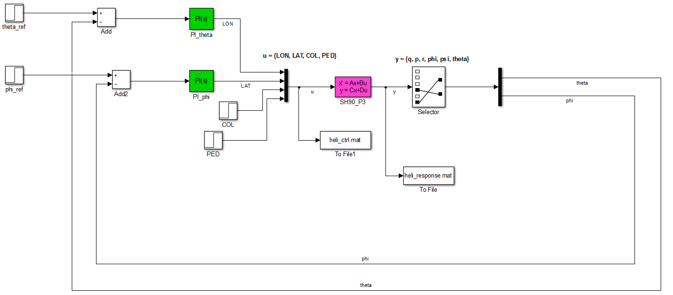
Considered FCS scheme
Outer-loop with PI controller

Slide 8
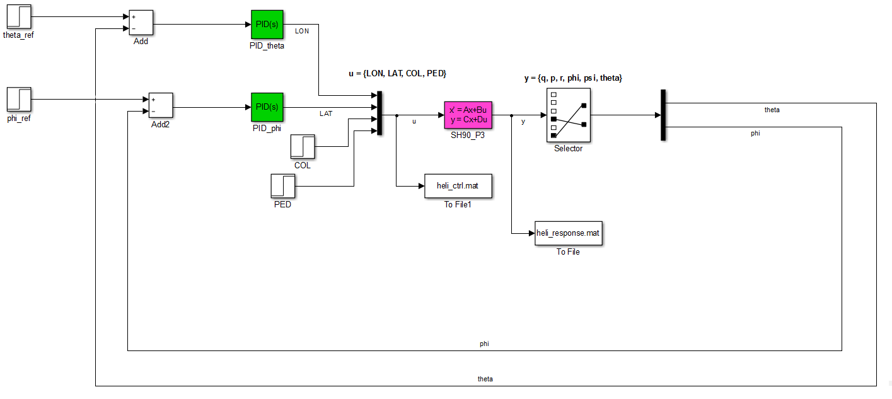
Considered FCS scheme
Outer-loop with PID controller

Slide 9
Adopted tuning requirement
Requirement definition for the adopted Matlab tuning function systune -> track set-point in theta and phi with zero steady-state error and defined rise times
The response of theta and phi to step command theta_ref, phi_ref, must resemble a decoupled first-order response with 1 sec. time constant
The maximum mismatch (in percentage) with respect to the reference first order model response must be less than 20%

Slide 10
Tuning results – scheme with PI blocks
Trim condition | P gain PI phi | I gain PI phi | P gain PI theta | I gain PI theta
V=90 kts, W=2800 kg | -107 | -54.2 | 64.8 | 44.7
V=147 kts, W=2800 kg | -172 | -100 | 64.8 | 43.3
V=151 kts, W=2800 kg | -188 | -77 | 51.4 | 34.8
V=90 kts, W=2120 kg | -82.2 | -34.6 | 54.8 | 22.8
V=147 kts, W=2120 kg | -159 | -74.6 | 64.9 | 31
V=151 kts, W=2120 kg | -186 | -87.1 | 74 | 32.9

Slide 11
Tuning results – scheme with PID blocks
Trim condition | P gain PID phi | I gain PID phi | D gain PID phi | Filter gain PID phi
V=90 kts, W=2800 kg | -80.7 | -75 | -50.4 | 1.5175e+04
V=147 kts, W=2800 kg | -81 | -130 | -65.6 | 86.9565
V=151 kts, W=2800 kg | -148 | -136 | -61 | 116.2791
V=90 kts , W=2120 kg | -71.6 | -43.5 | -34.9 | 9.0909e+03
V=147 kts, W=2120 kg | -130 | -141 | -53.5 | 578.0347
V=151 kts, W=2120 kg | -212 | -160 | -60 | 204.0816
Trim condition | P gain PID theta | I gain PID theta | D gain PID theta | Filter gain PID theta
V=90 kts, W=2800 kg | 70.2 | 53.4 | 29.9 | 1.1312e+04
V=147 kts, W=2800 kg | 57.7 | 50.6 | 33.4 | 5000
V=151 kts, W=2800 kg | 46.8 | 40 | 25.2 | 487.8049
V=90 kts , W=2120 kg | 55.9 | 25.6 | 19.8 | 5.7471e+03
V=147 kts, W=2120 kg | 67.1 | 33.9 | 16.9 | 502.5126
V=151 kts, W=2120 kg | 80.3 | 36.4 | 13.2 | 869.5652

Slide 12
Simulation results
ISA 15°C S.L., V=90 kts, W=2800 kg, CG long. position = 3.37m
Simulation over 10sec., imposed a pedal step command of 20% (from t=1sec.), null set-point on theta and phi

Slide 13
Simulation results
ISA 15°C S.L., V=147 kts, W=2800 kg, CG long. position = 3.37m
Simulation over 10sec., imposed a pedal step command of 20% (from t=1sec.), null set-point on theta and phi

Slide 14
Simulation results
ISA 15°C S.L., V=151 kts, W=2800 kg, CG long. position = 3.37m
Simulation over 10sec., imposed a pedal step command of 20% (from t=1sec.), null set-point on theta and phi

Slide 15
Simulation results
ISA 15°C S.L., V=90 kts, W=2120 kg, CG long. position = 3.50m
Simulation over 10sec., imposed a pedal step command of 20% (from t=1sec.), null set-point on theta and phi

Slide 16
Simulation results
ISA 15°C S.L., V=147 kts, W=2120 kg, CG long. position = 3.50m
Simulation over 10sec., imposed a pedal step command of 20% (from t=1sec.), null set-point on theta and phi

Slide 17
Simulation results
ISA 15°C S.L., V=151 kts, W=2120 kg, CG long. position = 3.50m
Simulation over 10sec., imposed a pedal step command of 20% (from t=1sec.), null set-point on theta and phi

Slide 18
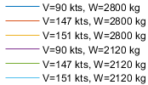
Simulation results
Compare ALL trim conditions, PI controllers
Simulation over 10sec., imposed a pedal step command of 20% (from t=1sec.), null set-point on theta and phi

Slide 19
Simulation results
Compare ALL trim conditions, PID controllers
Simulation over 10sec., imposed a pedal step command of 20% (from t=1sec.), null set-point on theta and phi

Slide 20
Conclusions
The controller is able to track the null angle set-point on both pitch and roll when a pedal step command is applied
From the comparison between PI and PID performance, it seems that the PID does not guarantee a clear improvement respect to the simpler PI. Hence from the Matlab/Simulink simulations both PI and PID should be valid for the Flightlab implementation

